Slide 1


NUOVE PROSPETTIVE PER IL GERD POST-MBS
Angelo Iossa MD PhD
Researcher Sapienza University of Rome
Head Bariatric Centre of Excellence SICOB
ICOT Hospital- Latina

Slide 2

The problem

Slide 3
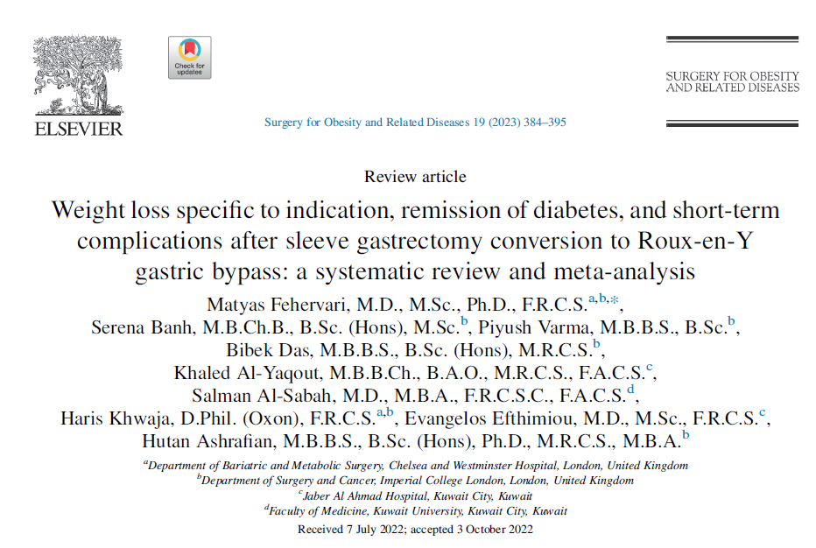
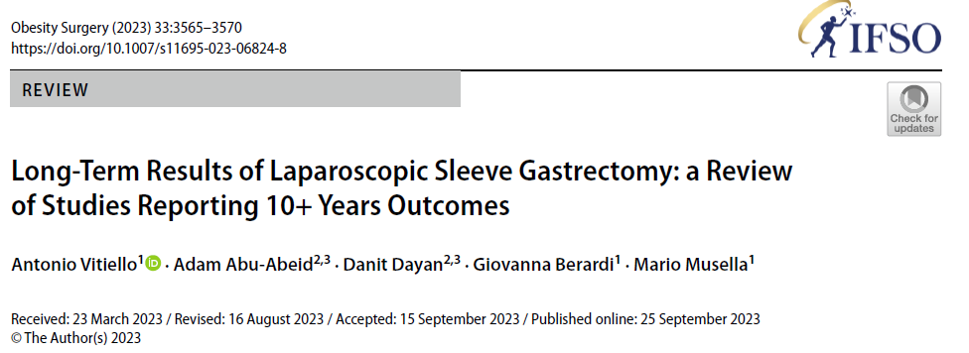
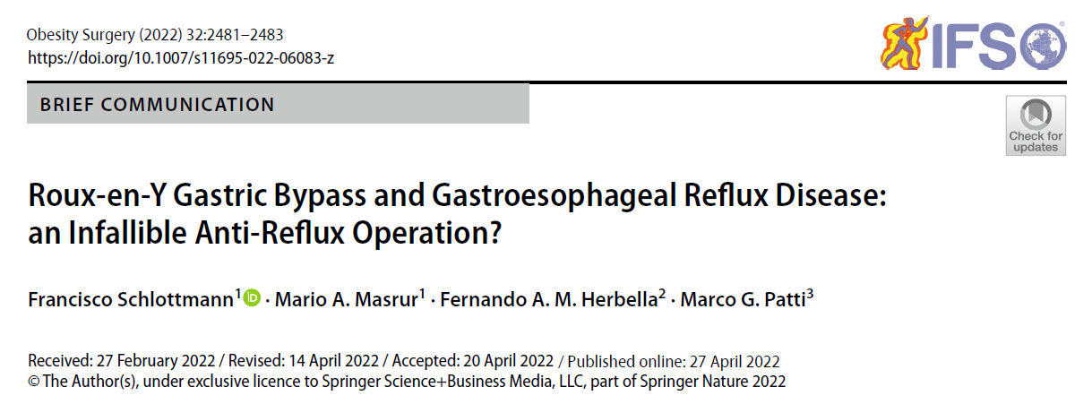
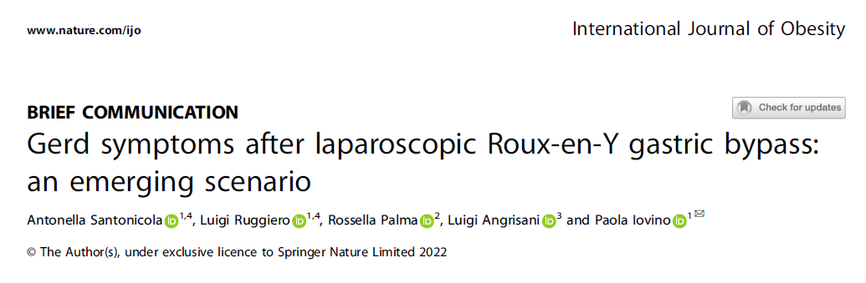
GERD rise and fall of bariatric surgery
Post Sleeve GERD 32.3% (21.4–58.4%)..
revisional reason 30%
Post GBP GERD (recurrence)(24- 47%)

Slide 4
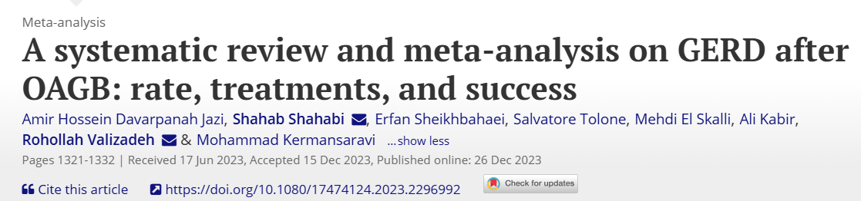
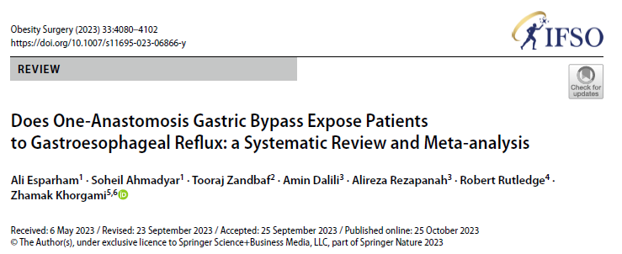
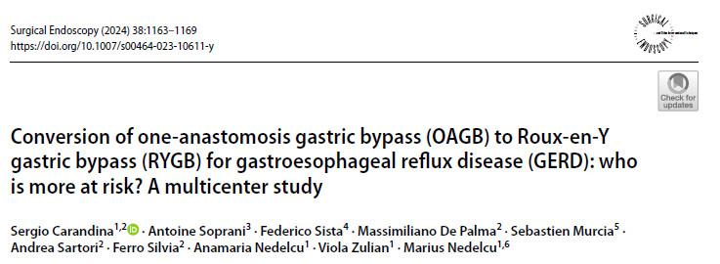
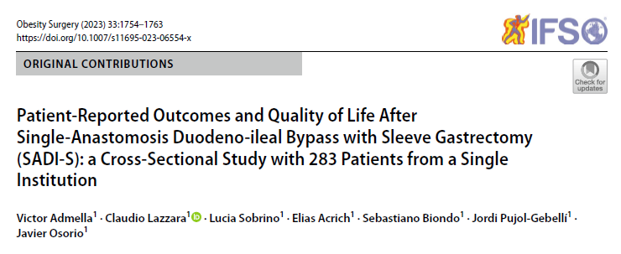
GERD rise and fall of bariatric surgery
Post OAGB GERD 0-55%
2% (?)
Revisional indication (1%)
Post SADI-S GERD 17% (1 y) -30% (3 y)

Slide 5


Slide 6
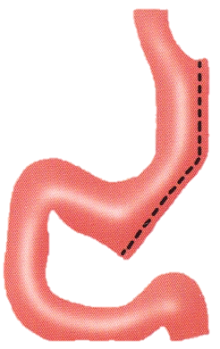
Increase intragastric pressure
Functional stenosis
Stomach division too close to the esophagus (sling fibers weakness)
HH (unrecognized or de novo)

Slide 7
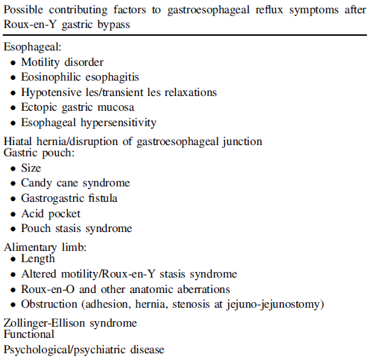
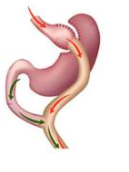

Slide 8
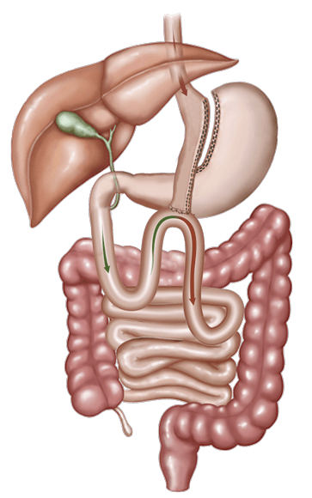
Surgical and anatomical factors
Single-loop anatomy
Anastomosis tension
Gastric pouch size
Larger pouch
Smaller pouch
Other contributing factors
Hiatal hernia

Slide 9
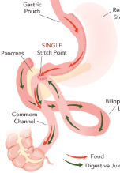


Slide 10

What’s new on treatment?

Slide 11
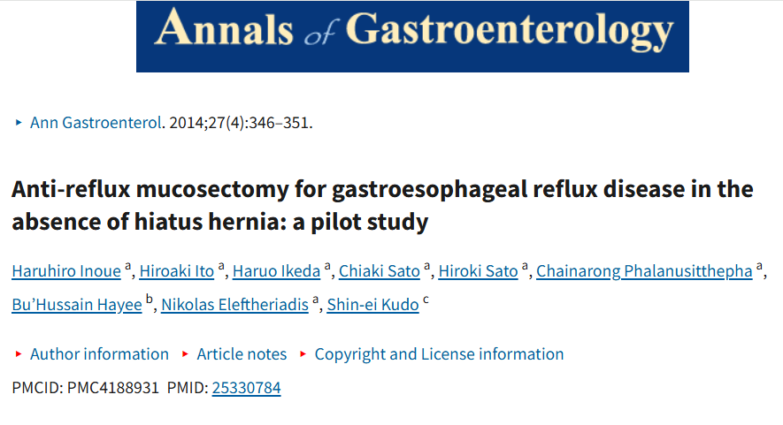


ARMS
ARMA
ARM-p
ARM-b

Slide 12
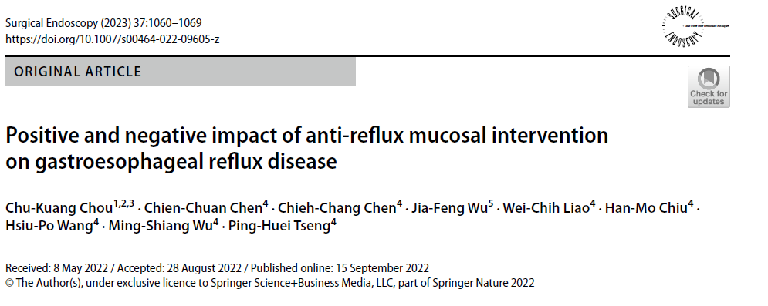

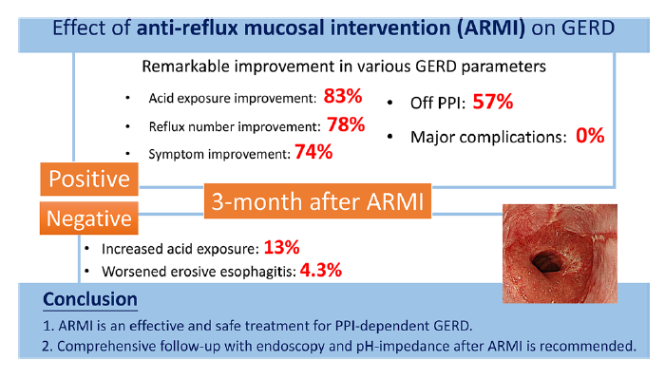
23 non bariatric pts
3 M FU

Slide 13
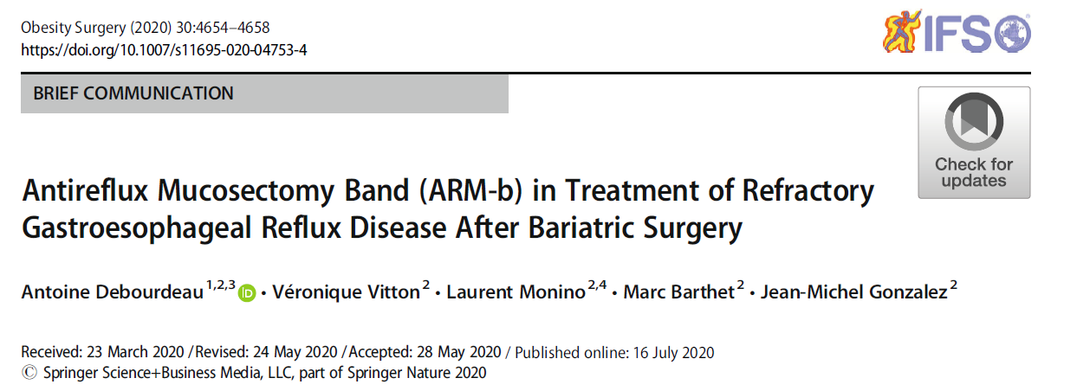

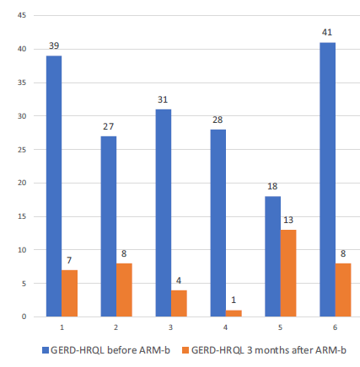
6 pts
3 M FU
Success rate 100%
Sympt control 83.3%
Complic rate 33% (1 strict, 1 bleeding)

Slide 14
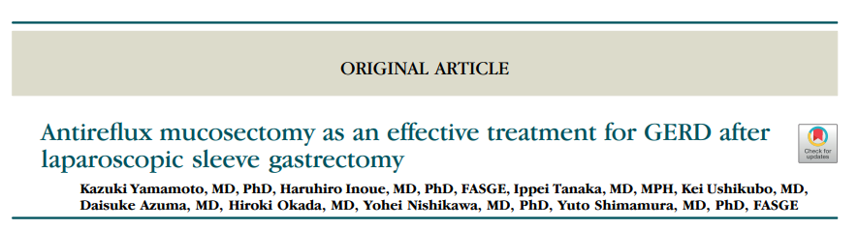

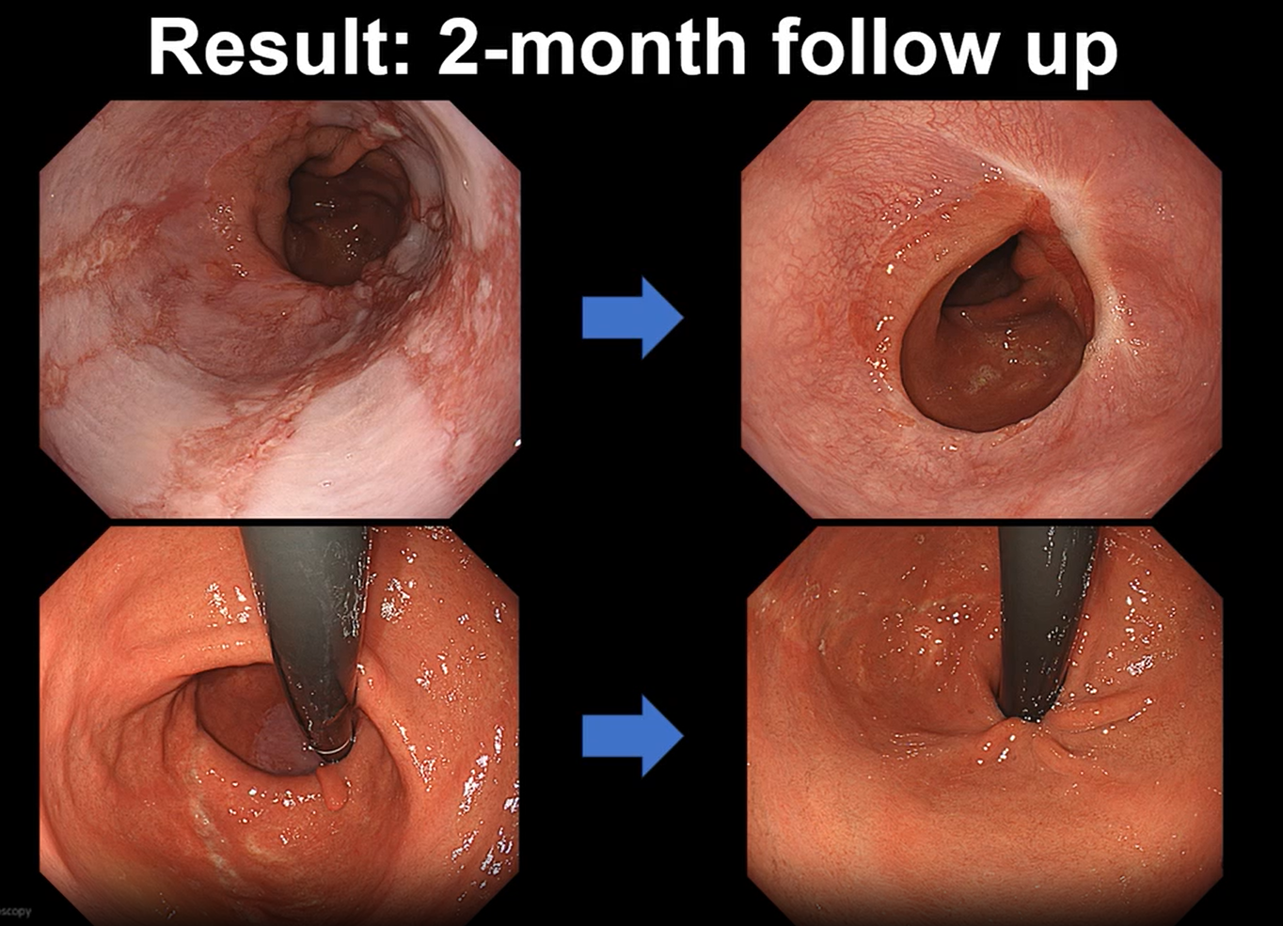
2024

Slide 15
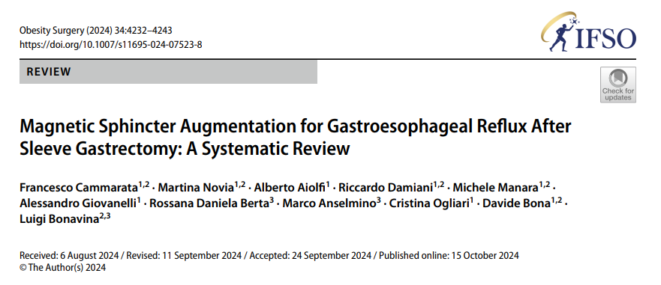

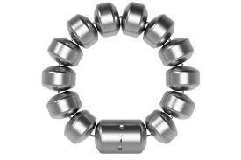
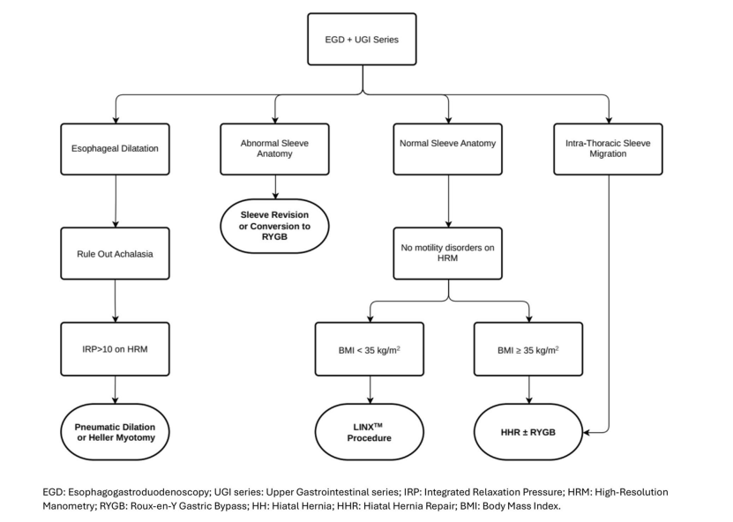
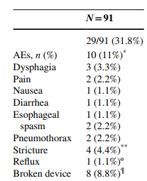
FDA
2012
109 patients (14 studies).
Median follow-up was 18.9 months (range 0.3–63).
Results
Reduction of daily PPI use (97.4% vs. 25.3%)
GERD-HRQL score of 35.54 ± 18.88 decreased to 17.27 ± 16.7
DeMeester score (3 studies) reduction compared to baseline (47.2 ± 22 vs. 24.3±15).

Slide 16
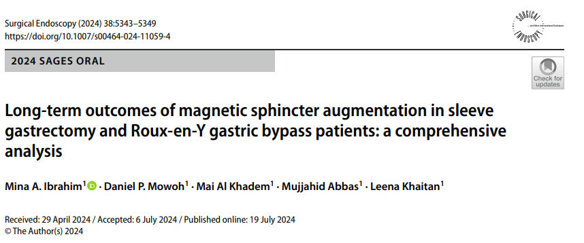

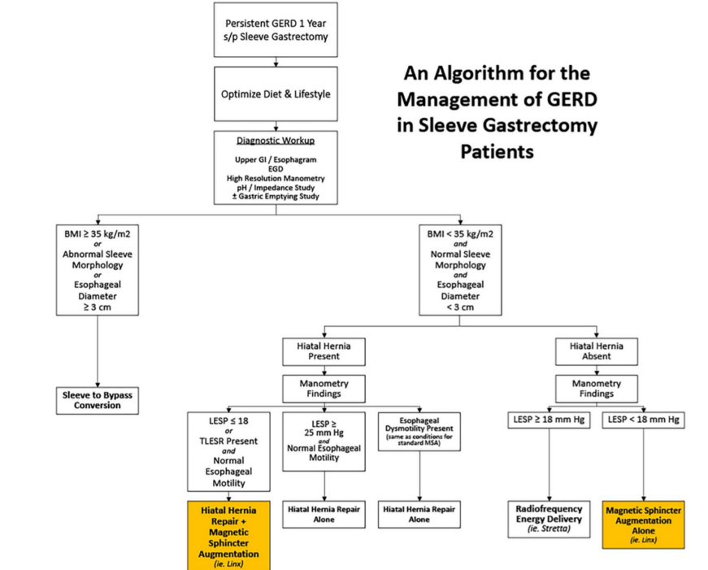
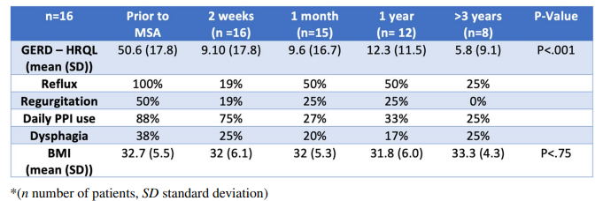
3 explanted (19%)

Slide 17
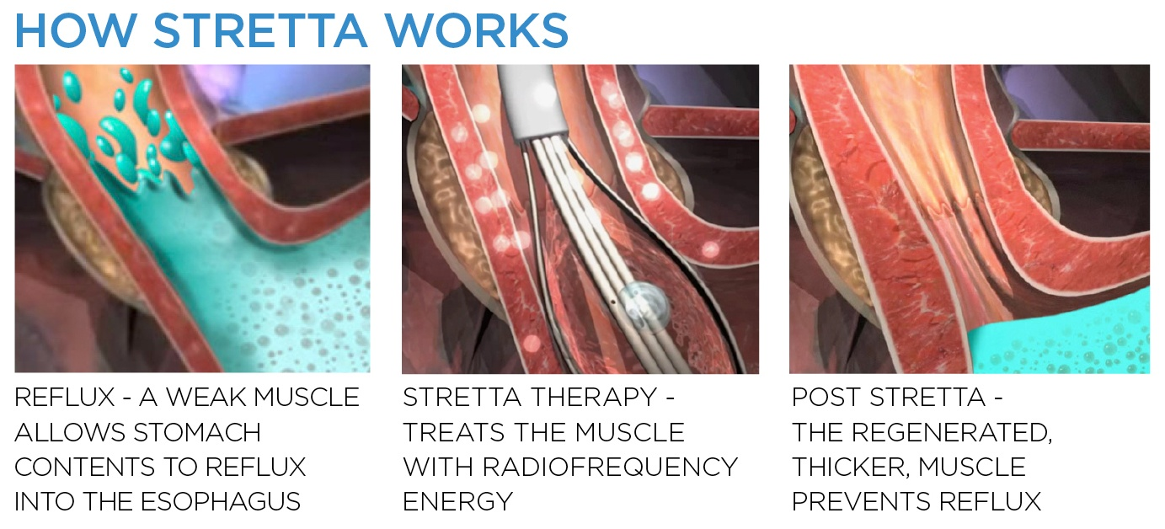
FDA
2000
BR
2010
ACG 2013 NO!
SAGES 2013 YES!

Slide 18
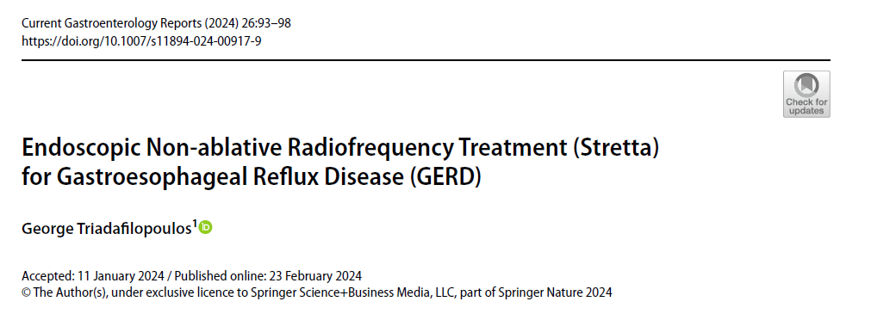

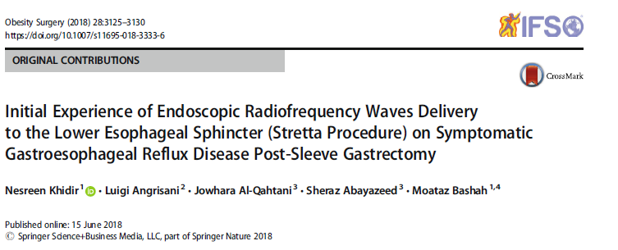
15 patients
6 months, 66.7% of patients were not satisfied
only 20% stopped PPI.
Two patients (13.3%) underwent Roux-en-Y gastric bypass

Slide 19
What’s new on prevention?

Slide 20
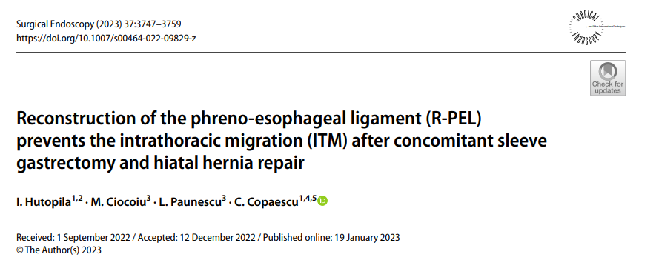
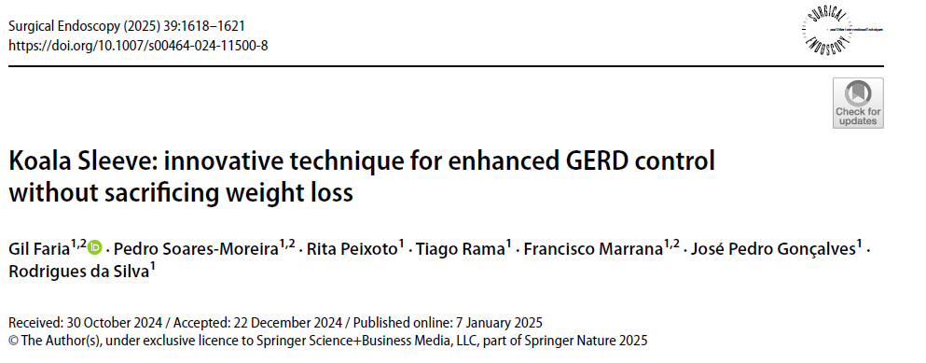
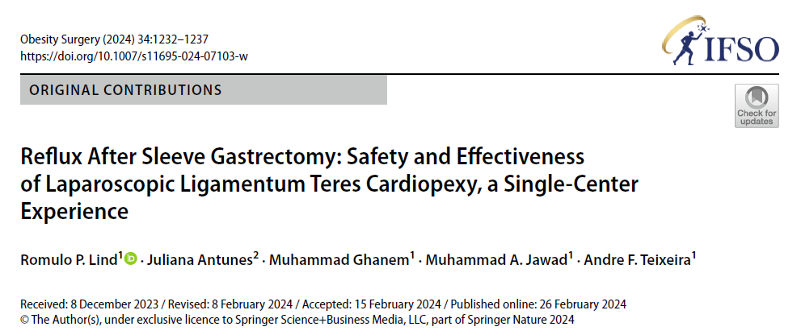
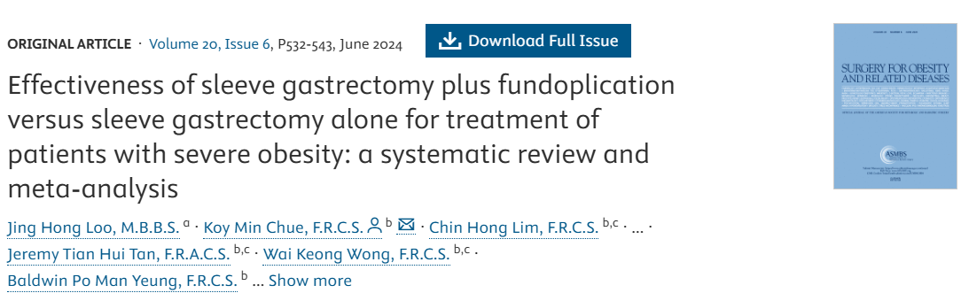
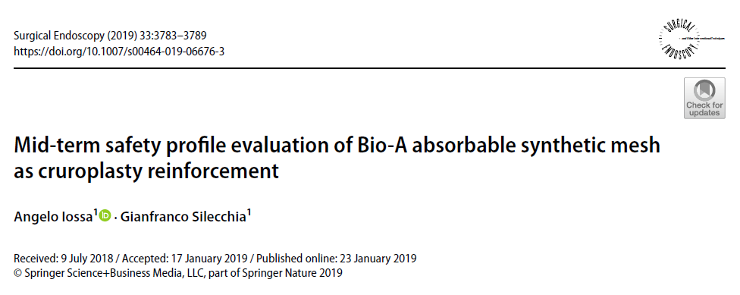
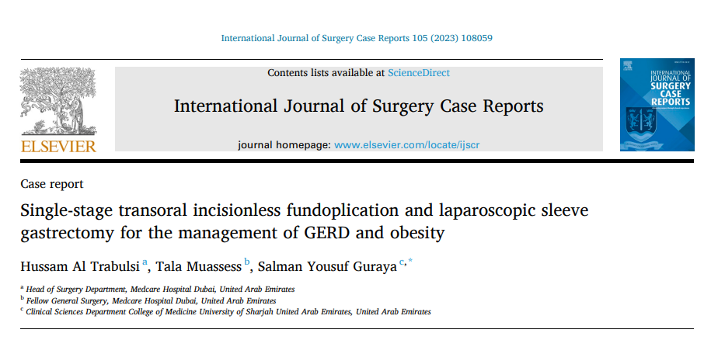
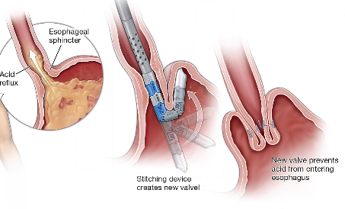
7 times less ITM
GERD REMISSION [OR] = 13.13; 95% CI, 3.54-48.73; I² = 0%).
74.4% PPI free
2.1% HH recurrence/conversion rate

Slide 21

sleeve

Slide 22

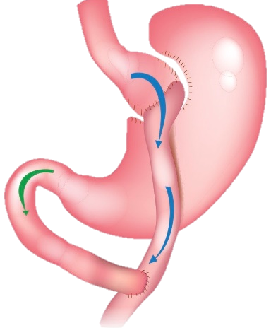
GERD

Slide 23
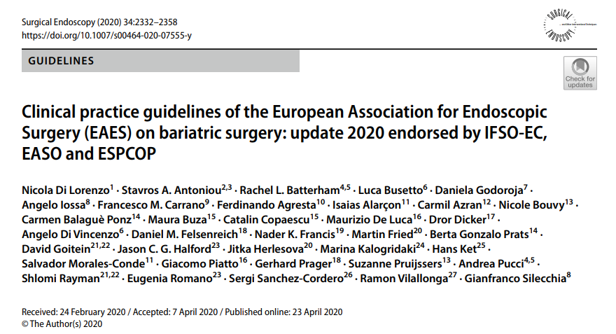
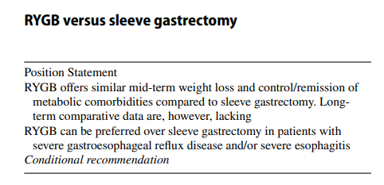


Slide 24
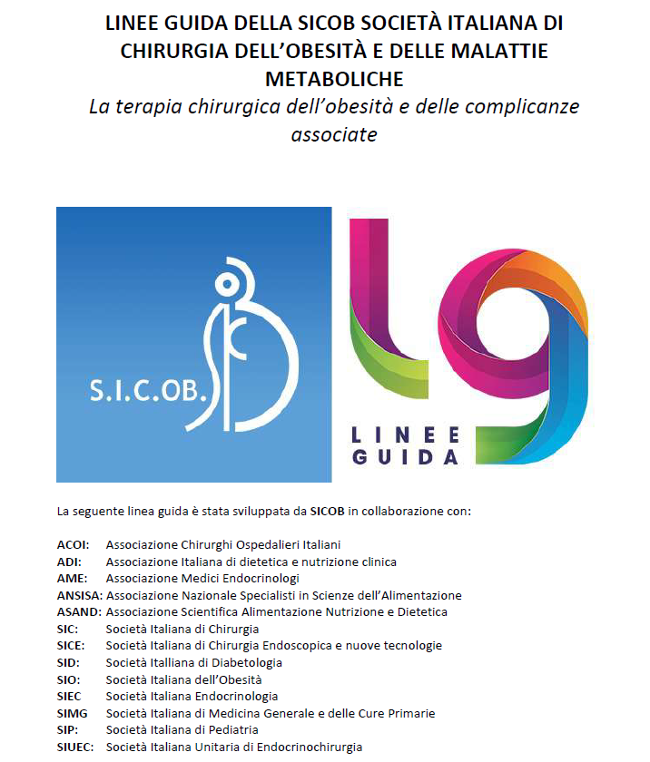
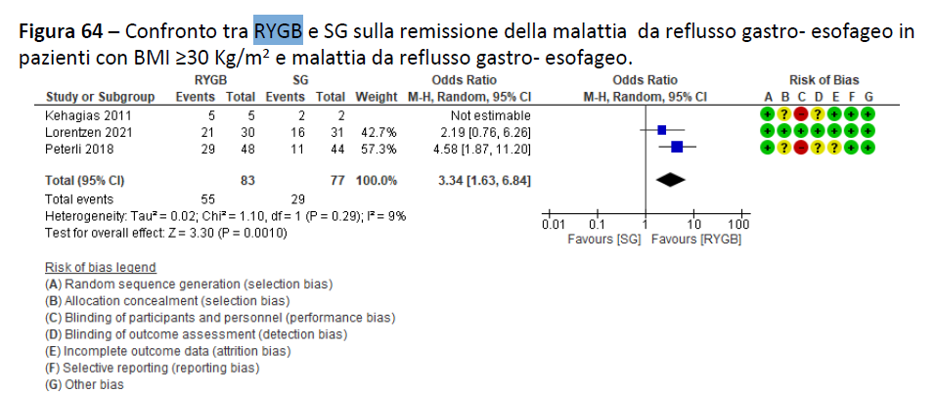
2023

Slide 25

Personal..
2014
2019
2024

Slide 26
CONCLUSIONS
MORE THAN 25% (mean value) OF PTS AFTER MBS CAN SUFFER BY GERD (DE NOVO OR RECURRENT)
SEVERAL MECHANISMS AFFECTS THE INCIDENCE AND MUST BE EVALUATED BEFORE TREATMENT
(avoid refluxogenic procedure in symptomatic/high risk pts- PREVENT)
1° RULE: EXCLUDE ANATOMIC COMPLICATIONS
(HH,ITM, SG STENOSIS, G-G FISTULAS, SHORT POUCH, LARGE POUCH, OBSTRUCTED ANASTOMOSIS OR AL, SHORT AL ETC..)
2° RULE: EVALUATE FUNCTIONAL ESOPHAGEAL DISEASE
3° RULE: CROSS THE FINGER AND DECIDE THE TREATMENT BASED ON PERSONAL EXPERIENCE
STEP-UP APPROACH
1° CONSERVATIVE…ENDOSCOPIC (IN EXPERIENCED CENTERS)..SURGICAL
AND REMEMBER..IT’S COMMONLY A LONG TERM COMPLICATION..FU IS CRUCIAL!!

Slide 27


Thank you!
Angelo.iossa@uniroma1.it
@angeloiossmd

